Slide 1
Implement Identity and Access Management
CompTIA Security+ Exam SY0-701
Lesson 4
Notes:
The first three lessons have presented a general overview of concepts and threats. The next few lessons will switch focus to security architecture and operations.
This lesson covers identity and access management (IAM). While this appears in the Security Operations domain in the exam objectives, we're covering it earlier in the course as the access control and authentication concepts underpin many other secure architecture design and security operations.

Slide 2
Objectives
Implement password-based and multifactor authentication
Implement account policies and authorization solutions
Implement single sign-on and federated identity solutions

Slide 3
Authentication
Lesson 4
Topic 4A
Notes:
This topic focuses on the implementation of password, multifactor, and passwordless authentication solutions.

Slide 4
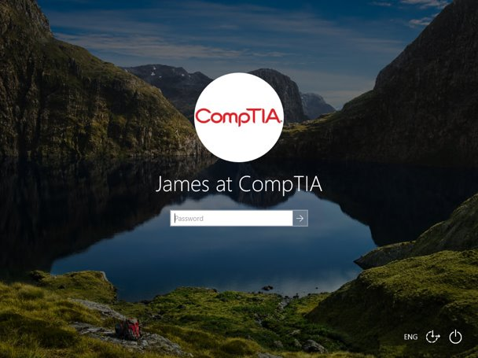
Authentication Design​
Meet requirements for confidentiality, integrity, and availability​
  Keeps credentials secure​ (confidentiality
  Threat actors cannot bypass or subvert the authentication mechanism​ (integrity​)
  Mechanism does not cause undue delay or support issues​ (availability​)
Something you know​: knowledge factor​
  Password​
  Personal identification number (PIN)​
Screenshot used with permission from Microsoft.
Notes:
Discuss problems with password-only systems before moving on to stronger authentication mechanisms.

Slide 5
Password Concepts
Length​
Complexity​
  Character combinations​
Aging​
Reuse​ and history
  Expiration
NIST guidance​
  Password hints​
Notes:
Students should appreciate that the exam objectives regard complexity and aging as appropriate policies, but make them aware of the updated NIST guidance.
Get students to research password breaches. Explain that these breaches have given threat actors a huge database of hashes and/or plaintext passwords plus emails or usernames to exploit in password spraying attacks.

Slide 6
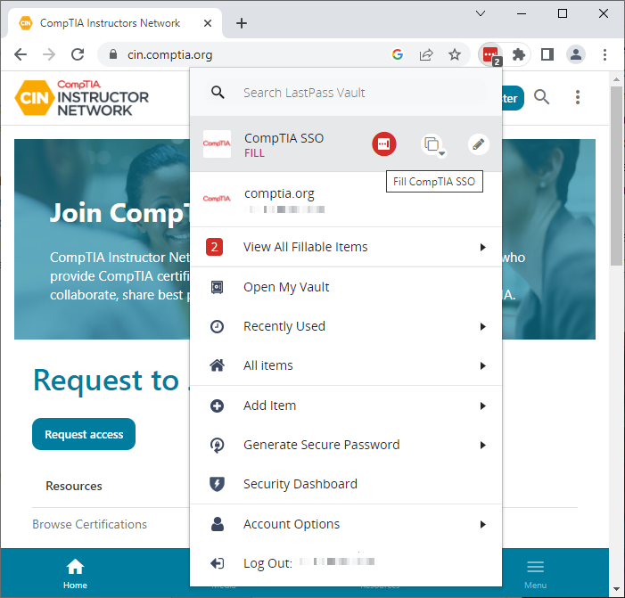
Password Managers
Vault and master password
  Built-in OS/browser password managers
  Third-party cloud/plug-in
Per-site password generation
Secure filling
Notes:
Explain that password managers facilitate the use of longer and more random passphrases than a user could remember. The apps do have vulnerabilities though.

Slide 7
Multifactor Authentication​
Multifactor authentication (MFA)​
  Something you KNOW and something you HAVE​
  NOT something you KNOW and something else you KNOW
Something you have​
  Ownership factor​: hardware tokens and fobs​
Something you are/do​
  Biometric factor​​​: fingerprint and facial scans
Somewhere you are​
  Geolocation via location services​
  IP/network location
Notes:
Explain how other factors can be used with a username/password to implement MFA.

Slide 8
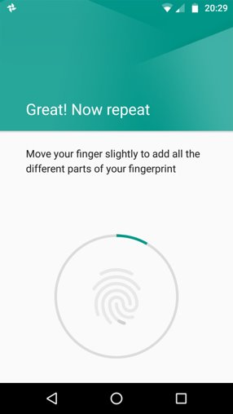
Biometric Authentication​
Enrollment​
  Sensor and feature extraction​
  Sensor/camera types
Efficacy rates and considerations​
  False Rejection Rate (FRR) or Type I error​
  False Acceptance Rate (FAR) or Type II error​
  Throughput, cost, and inaccessibility
Fingerprint recognition
Facial recognition
Android is a trademark of Google LLC.
Notes:
The latest exam objectives don't have the same level of detailed subobjectives for authentication factors. However, the metrics are listed in the acronyms list so we have included them here.
You might want to note the use of CAPTCHA here too. This isn't a content example, but it is in the acronyms list and included as a glossary term. CAPTCHA is designed to ensure that a human user is making the request or submitting a password, rather than a bot or script.

Slide 9
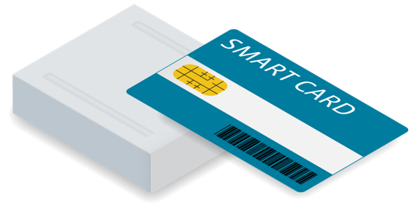

Hard Authentication Tokens
Token generation types
  Certificate-based (requires PKI)
  One-time password (OTP)
  Fast Identity Online (FIDO) Universal 2nd Factor (U2F)
Authenticator form factors
  Smart card
  One-time password (OTP)​ fob
  Security key
    Activation method to show presence
Image © 123RF.com.
Notes:
Hopefully students have a good grasp of cryptography from the previous lesson. You might want to remind them of why the properties of a key pair make it suitable for signing operations.
Multifactor authentication is a strong solution but can also be an expensive one. Along with hardware and software costs, there may be additional support costs when authentication fails and a valid user cannot access the network.
FIDO/U2F is not a subobjective, but it is worth mentioning in terms of general awareness of token key methods and the journey toward passwordless/FIDO2/WebAuthn.

Slide 10
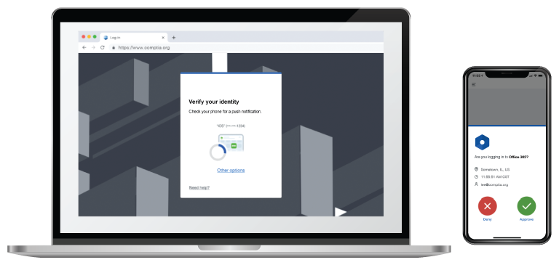
Soft Authentication Tokens
Transmit a code via an out-of-band channel​
  Short message service (SMS)​
  Email account​
  Phone call​
  Push notification​
Authenticator app
Possibility of interception​​
Notes:
The term "two-step verification" is not on the objectives document, but students should understand the difference between these mechanisms and hardware token keys.

Slide 11
Passwordless Authentication
Rely on authenticator rather than password
  Accounts identified by public/private key pair, but doesn’t have to use PKI
  Private key stored only on authenticator
  Authenticator can require biometric or PIN proof of presence (local gesture)
Attestation
  Verify authenticator as root of trust
Notes:
Note that MFA retains use of a password along with a token and/or biometric authenticator as an additional factor. Passwordless depends on use of an authenticator only.
As it's not on the exam objectives, we haven't mentioned Client to Authenticator Protocol (CTAP) or CTAP2. You might want to point out that the framework needs a secure way for a web browser to exchange data with an authenticator.
Make sure students understand the difference between attestation and authentication. Attestation involves proving that the device platform has a secure root of trust and can report its properties truthfully.

Slide 12
Authentication
Authentication design​
  Something you know/are/have
Password concepts and password managers
Multifactor authentication​
Biometric authentication​
Hard authentication tokens
  Smart cards, OTP generators, FIDO U2F
Soft authentication tokens
  Two-step verification
Passwordless authentication

Slide 13
Assisted Lab Managing Password Security

Slide 14
Access Management
Lesson 4
Topic 4B
Notes:
This topic looks at policies that ensure least privilege and govern the account provisioning process.

Slide 15
Discretionary and Mandatory Access Control​
Access control model determines how users receive permissions/rights​
Discretionary Access Control (DAC)​
  Based on resource ownership​
  Access Control Lists (ACLs)​
  Vulnerable to compromised privileged user accounts​
Mandatory Access Control (MAC)​
  Labels and clearance​
  System policies to restrict access​
Notes:
Real-world implementations of access control do not exactly conform to these models. Discuss some examples and ask students how they would categorize them. Emphasize the difference between discretionary and nondiscretionary/rule-based access control.
The key difference is where decision-making lies. With DAC, it lies with the resource owner. In MAC, it lies with the system owner (that is, the controls are enforced system wide and cannot be countermanded or excepted by users "within" the system).

Slide 16
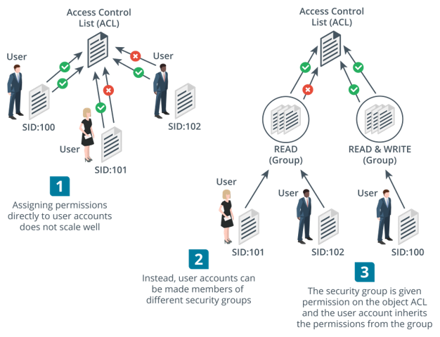
Role-based and Attribute-Based Access Control​
Role-Based Access Control (RBAC)​
  Non-discretionary and more centralized control​
  Based on defining roles then allocating users to roles​
  Users should only inherit role permissions to perform particular tasks​​
Security groups
  Assign permissions to security groups and assign user accounts to relevant groups​
  Groups can be mapped to roles
Attribute-Based Access Control (ABAC)​
  Access decisions based on a combination of subject and object attributes plus any context-sensitive or system-wide attributes​
Images © 123RF.com.
Notes:
Make sure students understand that roles and groups are not identical. Groups can be used to map to roles, but there are also explicitly role-based permissions systems.
You can direct students to Azure and/or AWS overviews of their IAM role-based permissions systems for more detail.

Slide 17
Rule-Based Access Control​
Non-discretionary​
  System determines rules, not users​
  MAC, RBAC, and ABAC
Conditional access​
  Continual authentication​
  User account control (UAC)​ and sudo
Notes:
Rule-based access control is also not necessarily dependent on the identity of the user (a firewall ACL, for instance).

Slide 18
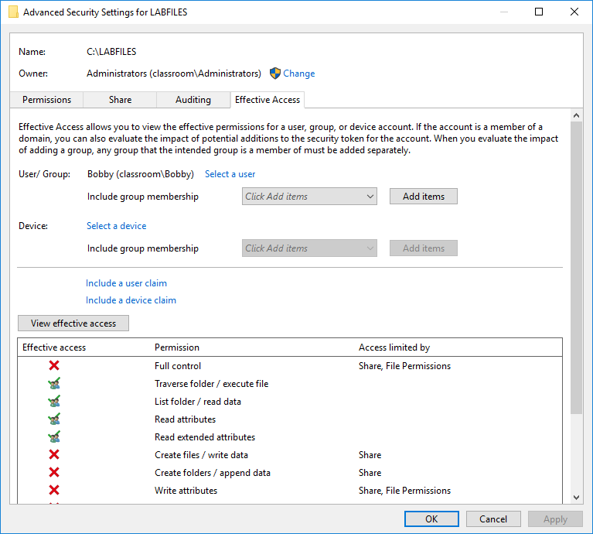
Least Privilege Permission Assignments
Principle of least privilege
  Sufficient permissions only
Implications
  Insufficient permissions
  Authorization creep
  Auditing
Notes:
Check that students are familiar with the concept of default administrator/root permissions. Allowing these "standing permissions" has been the cause of many security breaches.

Slide 19
User Account Provisioning
Provisioning
  Identity proofing
  Issuing credentials​
  Asset allocation ​
  Policy awareness and security education
  Permission assignments and implications
Deprovisioning
  Employees or contractors leaving company or project, or changing roles
  Remove or disable permission assignments
Notes:
We will be returning to cover the topics of security governance, policies, and procedures later in the course.

Slide 20
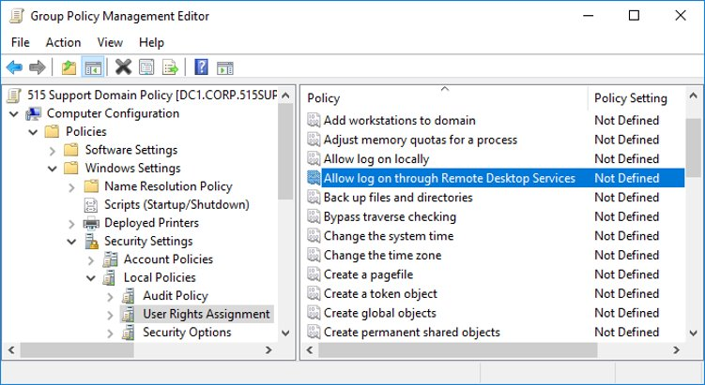
Account Attributes and Access Policies​
Account attributes​
  Security identifier (SID, account name, credential​)
  Extended profile attributes​
  Per-app settings and files​
Access policies​
  File permissions​
  Access rights​
  Active Directory Group Policy Objects (GPOs)​
Screenshot used with permission from Microsoft.

Slide 21
Account Restrictions​
Location-based policies
  Network/logical location
  Geolocation​
    By IP address​
    By Location Services​
Time-based restrictions​
  Logon hours​
  Logon duration​
  Impossible travel time/risky login​
  Temporary permissions

Slide 22
Privileged Access Management
Policies, procedures, and technical controls to prevent the malicious abuse of privileged accounts​
  Accounts with system-wide access
  Secure administrative workstations
Policies​ for zero standing privileges for administrators
  Temporary elevation
  Password vaulting/brokering
  Ephemeral credentials
Notes:
Explain that while all accounts can receive permission privileges, a privileged account is most easily associated with administrator-/root-/system owner-level permissions. Note, however, that any level of administrative permissions that could be used to affect the security model is a privileged account.
We'll discuss data privacy later, but you might also raise the notion that a privileged account could also be one with access to top secret or private data.
Make sure students also understand that services and applications can also have privileged access.

Slide 23
Access Management
Discretionary and mandatory access control​
Role-based and attribute-based access control​
Rule-based access control​
Least privilege permission assignments
User account provisioning
  Identity proofing, secure credentials, asset allocation, policy/awareness training, permissions assignments
Account attributes and access policies​
Account restrictions​
  Location- and time-based
Privileged access management
  Zero standing privileges and ephemeral/vaulted credentials

Slide 24
Assisted Lab: Managing Permissions

Slide 25
Identity Management
Lesson 4
Topic 4C
Notes:
This topic looks at how identities and authorizations can be managed using directories, SSO, and federation.

Slide 26
Local , Network, and Remote Authentication​
Authentication providers​
  Passwords versus password hashes​
Windows authentication​
  Local sign-in​
  Network sign-in (Kerberos and NTLM)​
  Remote sign-in​
Linux authentication​
  /etc/passwd and /etc/shadow​
  Pluggable authentication modules (PAMs)​
Notes:
The exam objectives do not mention local authentication specifically, although PAM is in the acronyms list and students will need to know what LSASS is. Check that students understand that a login can have the scope of a local machine's password database or use a network directory.

Slide 27
Directory Services​
Database of subjects​
  Users, computers, security groups/roles, and services​
Access Control Lists (authorizations)​
X.500 and Lightweight Directory Access Protocol (LDAP)​
  Distinguished names​
  Attribute=Value pairs​​
CN=WIDGETWEB, OU=Marketing, O=Widget, C=UK, DC=widget, DC=foo
Notes:
Directory services are critical to the function of most enterprise networks. They are used over the Internet (IM user directories, for instance). The main concerns are with the confidentiality of the information (read access), the integrity of the information (write access), and the DoS (preventing network access by knocking out the directory server).

Slide 28
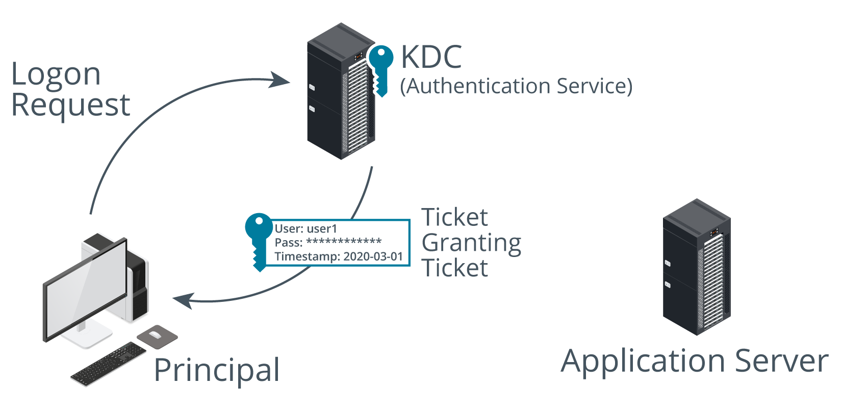
Single Sign-on Authentication​
Kerberos
  Clients​
  Application servers​
  Key Distribution Center (KDC)​
Authentication Service – Ticket Granting Ticket​
Ticket Granting Service – Service Ticket​​
Notes:
Kerberos is no longer explicitly included in the exam objectives, so you may prefer to skip it in class. It does illustrate how SSO works, however.
Kerberos can be difficult to follow, with multiple use of secret and session keys from different sources. If you don't go through all the steps, stress the main point that Kerberos provides single sign-on through the use of tickets or tokens.
The server can decrypt the request because it holds a copy of the user's password hash. This shows that the user has entered the correct password and that the system time is valid.

Slide 29
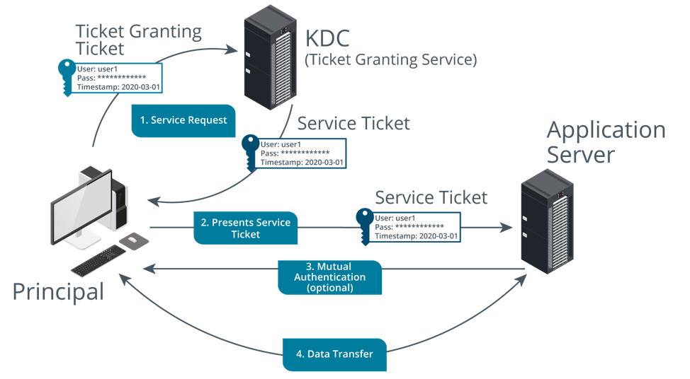
Single Sign-on Authorization​
Images © 123rf.com.
Notes:
The client does not know the application server's password and vice versa. Only the KDC knows both passwords.

Slide 30
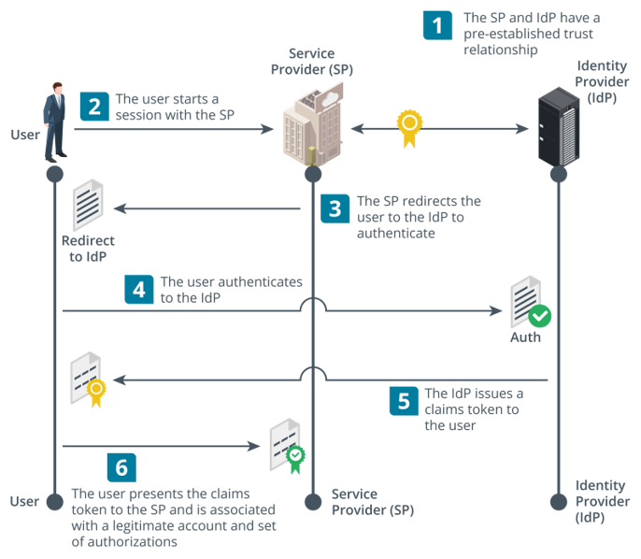
Federation
Networks under separate administrative control share user identities
Identity providers and claims
Interoperability
  Service providers and identity providers
  Shared frameworks and protocols
Images © 123rf.com.
Notes:
Make sure that students understand the concepts of federation and trusts and that SAML and OAuth are means of exchanging authorizations in a federated network.

Slide 31
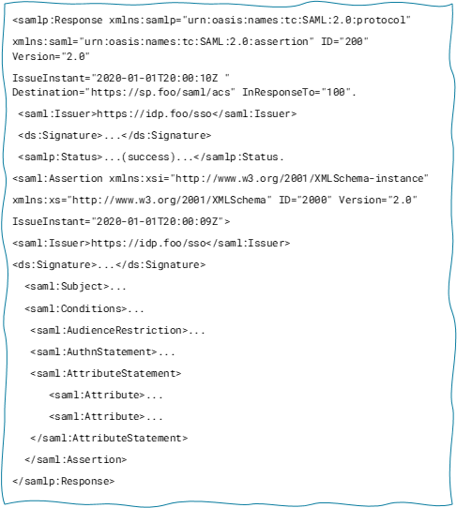
Security Assertion Markup Language​
Open standard for implementing identity and service provider communications​
Attestations/assertions​
  XML format​
  Signed using XML signature specification​
Communications protocols​
  HTTPS​
  Simple Object Access Protocol (SOAP)​​
Notes:
While SAML is complex, make sure students understand that it allows services to be separated from identity providers and not have to authenticate users directly. The service provider does not authenticate the user; it obtains an assertion from the identity provider that it has authenticated the user.
Students should also be able to recognize the general format of SAML claims.

Slide 32
Open Authorization
“User-centric” federated services better suited to consumer websites​
  Representational State Transfer (REST) Application Programming Interfaces (APIs) (RESTful APIs)​
  Framework for implementation not a protocol​
OAuth​
  Designed to communicate authorizations, rather than explicitly authenticate a subject​
  Client sites and apps interact with OAuth IdPs and resource servers that hold the principal’s account/data​
  Different flow types for server to server or mobile app to server​
  JavaScript object notation (JSON) web token (JWT)​
Notes:
Stress that an OAuth client is not the user. It is a website or mobile app interacting with an OAuth IdP or resource server.

Slide 33
Identity Management
Local, network, and remote authentication​
Directory services​
  LDAP and distinguished name attributes
Single sign-on authentication​ and authorization
  Kerberos
Federation
  Identity providers and service providers
Security Assertion Markup Language​
Open authorization (OAuth)

Slide 34
Summary
CompTIA Security+ Exam SY0-701
Lesson 4
Notes:
Check that students are confident about the content that has been covered. If there is time, revisit any content examples that they have questions about. If you have used all the available time for this lesson block, note the issues and schedule time for a review later in the course.
Optionally, discuss with students what authentication technologies are used in their workplaces. Do students have any experience with advantages or disadvantages of smart cards or biometric technologies? Is there single sign-on across local networks and cloud services, and if so, how is this implemented?

